Slide 1
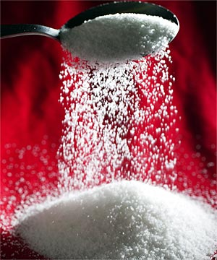
GLUCOSE
By Petra Čulo

Slide 2
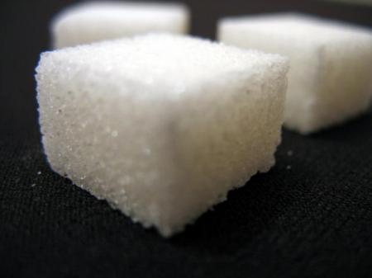
Glucose is a major component of sucrose, the substance we mean when we refer to sugar.

Slide 3
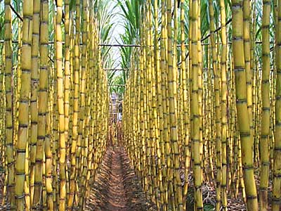
Specific names of sugar:
Cane sugar (South Pacific or southen India)

Slide 4
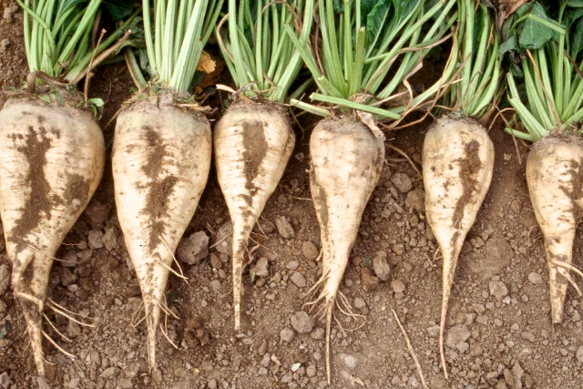
Beet sugar

Slide 5
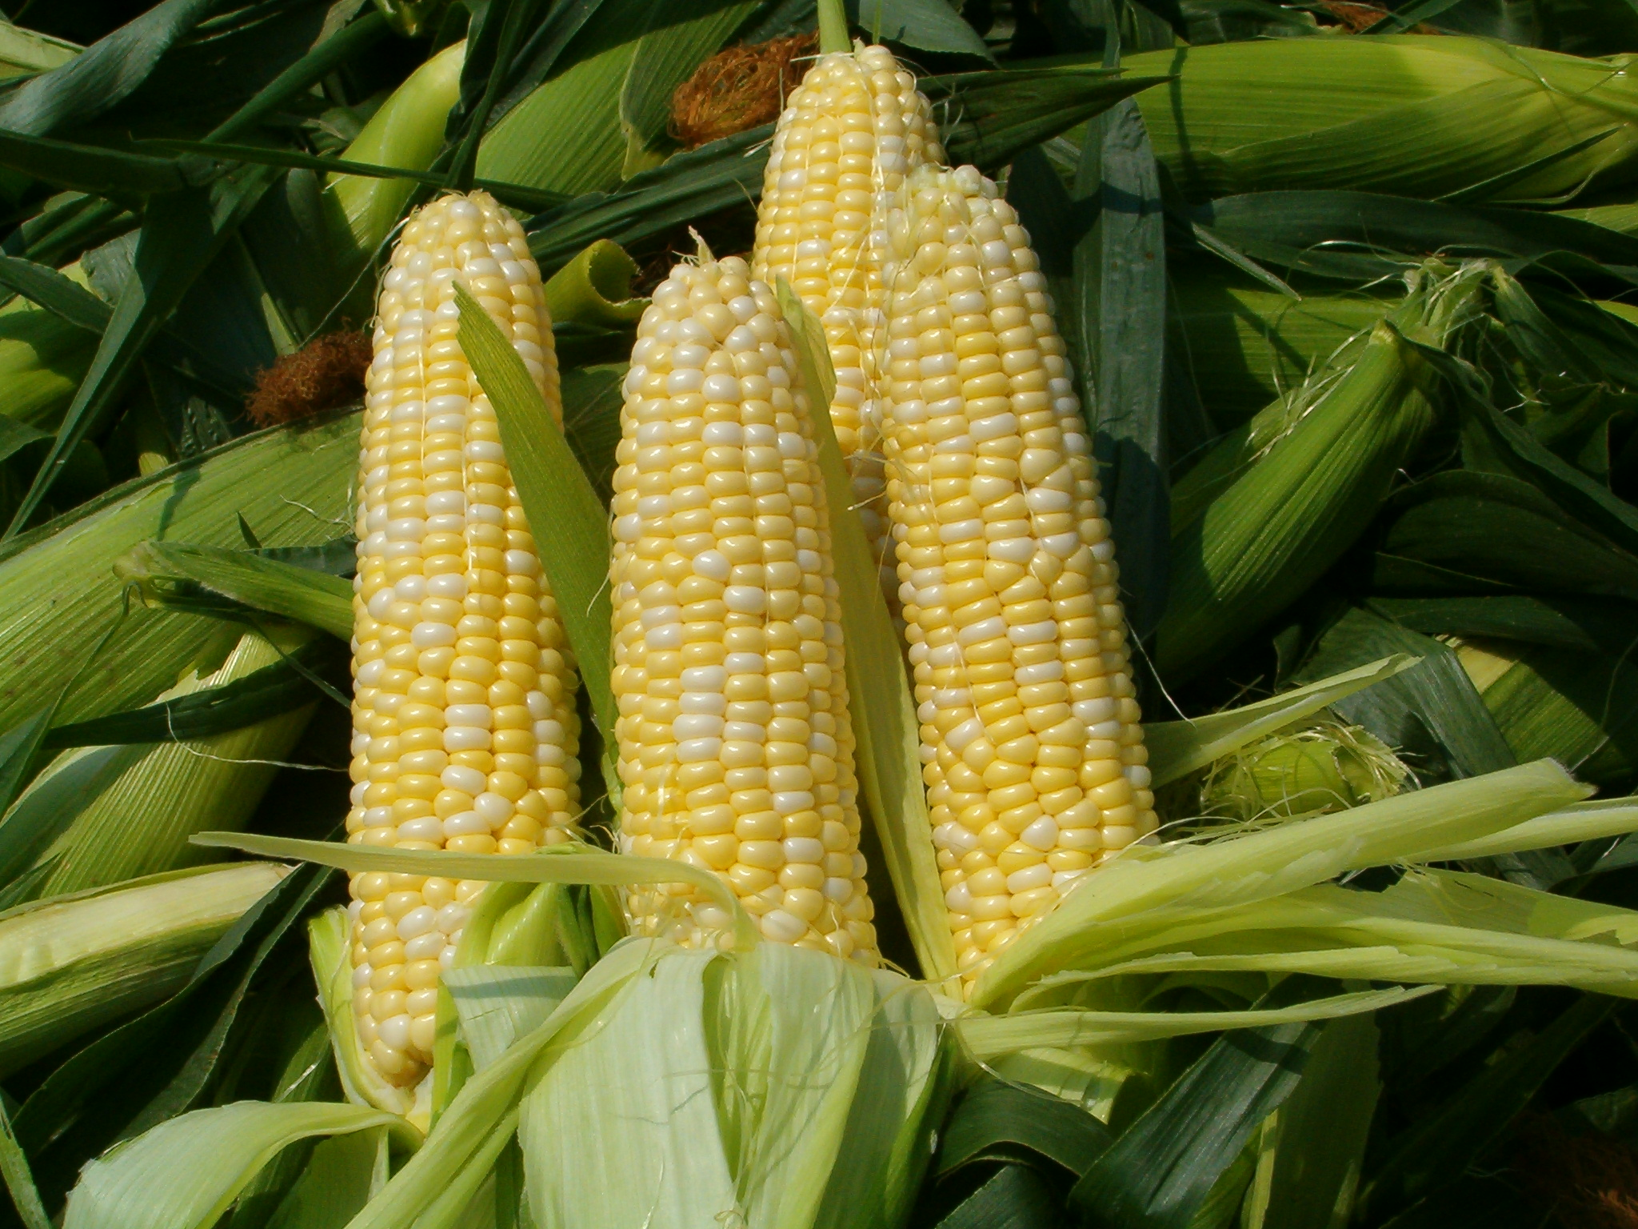
Corn sugar

Slide 6
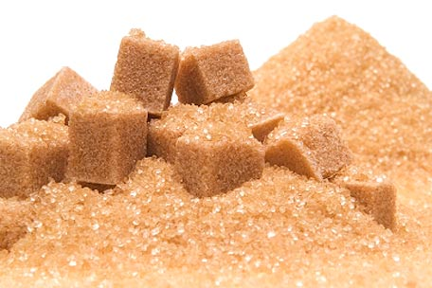
Sugar also comes in a number of variations:
Brown sugar

Slide 7
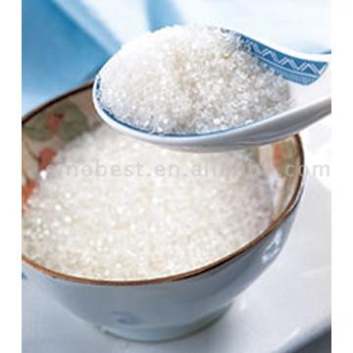
White sugar

Slide 8
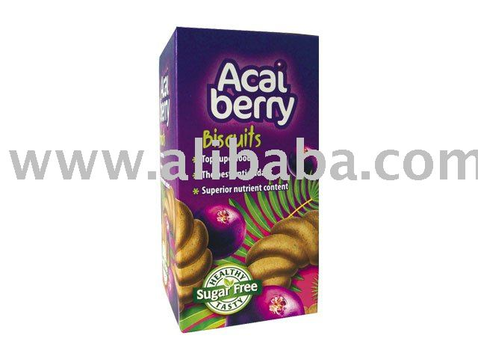
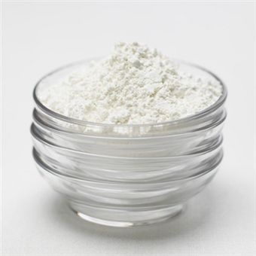
Berry sugar
Castor sugar

Slide 9
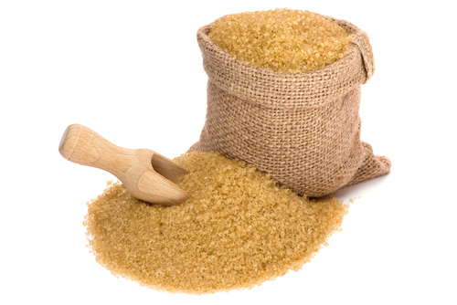
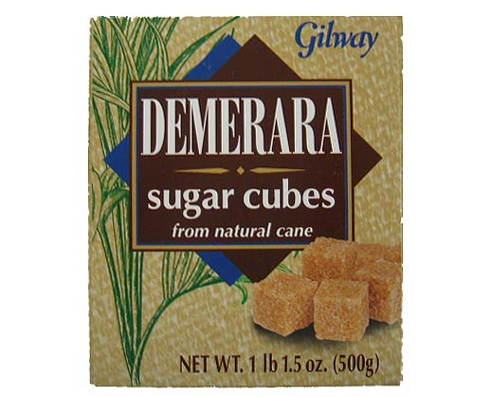
Raw sugar
Demerar sugar

Slide 10
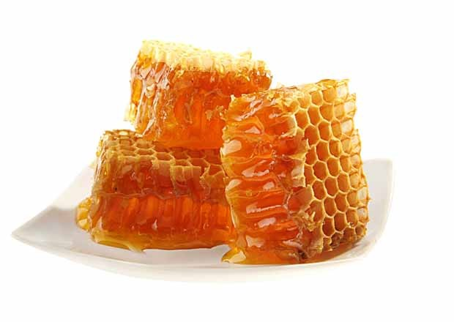
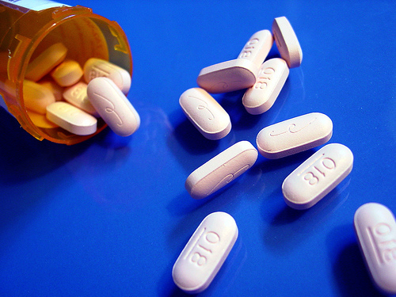
Sugar was used in medicine to disguise the often- nauseating taste of other ingredients, to act as a binding agent for drugs, and as a medicine in itself.

Slide 11
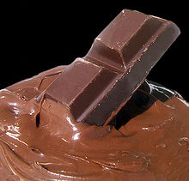
16th century – sugar become more popular
(consumed in the newly popular drinks of tea, coffee, and chocolate)
Sugar was also being used in sweet treats: syrup-covered, nuts and seeds, marzipan, cakes, and candies.

Slide 12
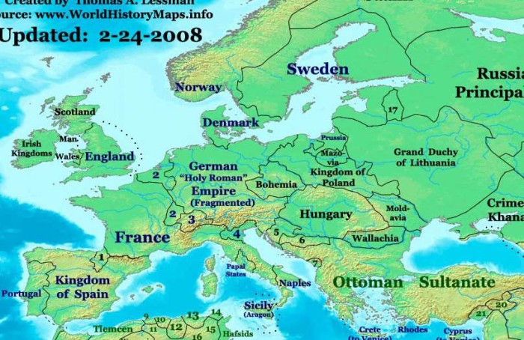
Slavery and Sugar Cultivation
The prospect of deriving great welth from sugar cultivation was enough for: England, France, Holland, Prussia, Denmark, and Sweden

Slide 13
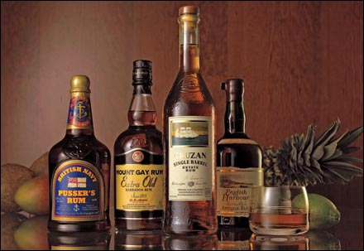
The rapidly expanding demand for sugar, the growing technology of sugar procesing, and the development of new alcoholic drink, rum.

Slide 14
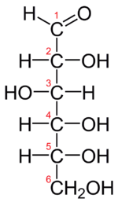
Sweet Chemistry
Glucose is the most common of the simple sugars, which are sometimes called monosachaides (Latin word saccharum for sugar)
A straight chain:

Slide 15
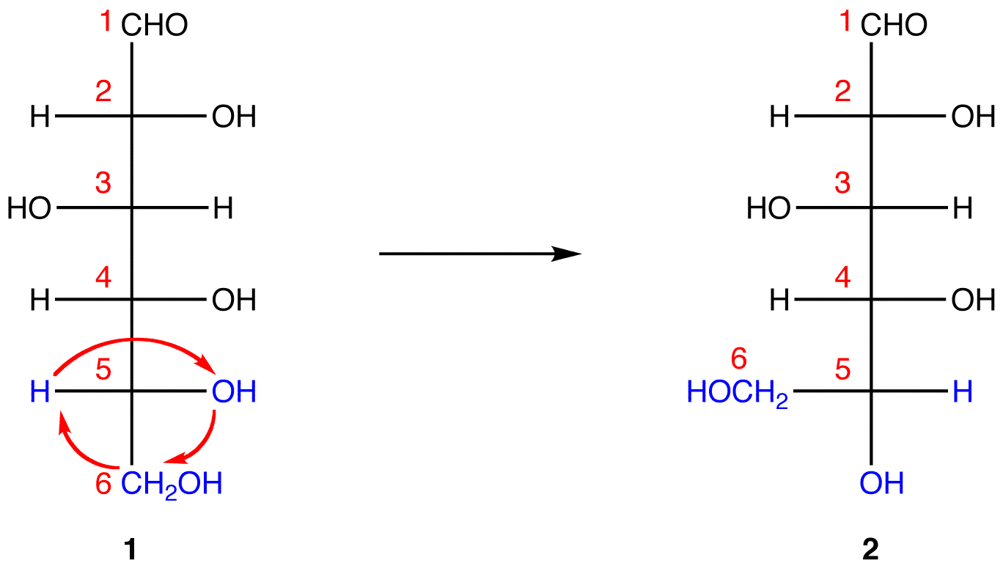
Fischer projection formula- a set of conventions that need not concern us give number to the carbon atoms, with carbon number 1 always drawn at the top.

Slide 16
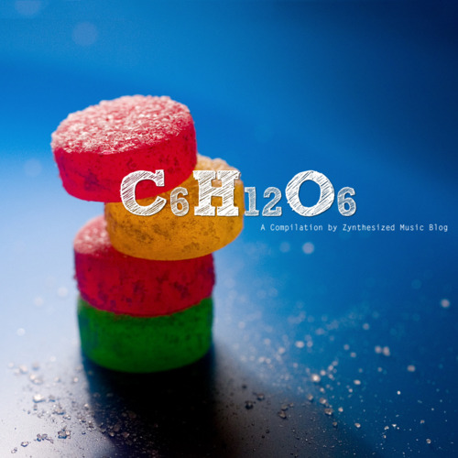
Fructose (fruit sugar) has the same formula as glucose; C6H12O6, and also the same number and types of atoms found in glucose.

Slide 17
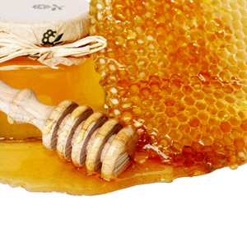
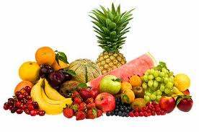
Fructose, find in fruit, but also in honey(honey is sweeter than sugar), which is about 38% fructose and 31%glucose, with another 10%of other sugars including sucrose.

Slide 18
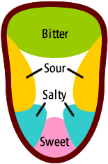
Sweet Taste
Sweetness is one of the four principals tastes; the othar three are:
1.Sourness
2. Bitterness
3. Saltiness

Slide 19
Thank you
THE END

