Slide 1
Energy
Petra Čulo,
Karla Rodić,
Maria Čaleta,

Slide 2
What is energy?
First lets see what the dictionary says:
the capacity for vigorous activity; available power: I eat chocolate to get quick energy.
an adequate or abundant amount of such power: I seem to have no energy these days.
physics
a. the capacity of a body or system to do work
b. E a measure of this capacity, expressed as the work that it does in changing to some specified reference state. It is measured in joules (SI units)

Slide 3
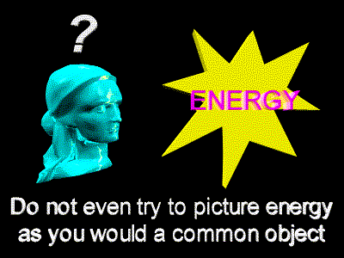
…
Energy comes in different forms:
- Heat (thermal)
- Light (radiant)
- Motion (kinetic)
- Electrical
- Chemical
- Nuclear energy
- Gravitational

Slide 4
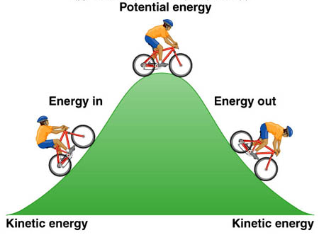
…
Energy is in everything. We use energy for everything we do, from making a jump shot to baking cookies to sending astronauts into space.
There are two types of energy:
Stored (potential) energy
Working (kinetic) energy

Slide 5
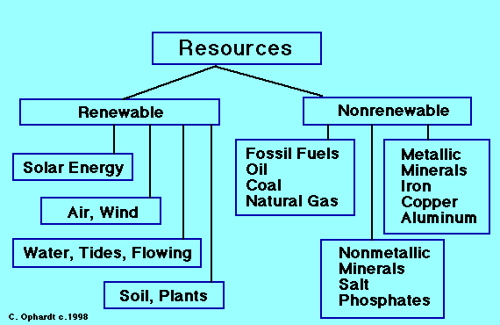
Energy Sources Can be Categorized As Renewable or Nonrenewable

Slide 6
Renewable energy sources include:
- Solar energy from the sun, which can be turned into electricity and heat
- Wind
- Geothermal energy from heat inside the Earth
- Biomass from plants, which includes firewood from trees, ethanol from corn, and biodiesel from vegetable oil
- Hydropower from hydro turbines at a dam

Slide 7
We use renewable and nonrenewable energy sources to generate the electricity we need for our homes, businesses, schools, and factories. Electricity "energizes" our computers, lights, refrigerators, washing machines, and air conditioners, to name only a few uses.
http://www.youtube.com/watch?v=o_5oYuDY2qM

Slide 8
Forms of Energy
Kinetic-energy of motion -->energy an object possesses because of its motion
Potential- stored energy --> object has mass and position WITHIN a force field

Slide 9
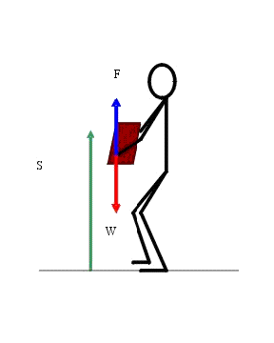
Potential
Gravitational: the energy an object has because of its position

Slide 10
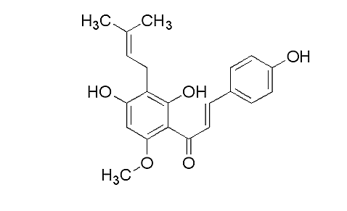
Potential
Chemical-energy stored in the bonds between the atoms -->undergo a transformation through a chemical reaction

Slide 11
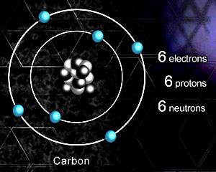
Potential
Nuclear-energy store in the nucleus of an atom --> holds them together

Slide 12
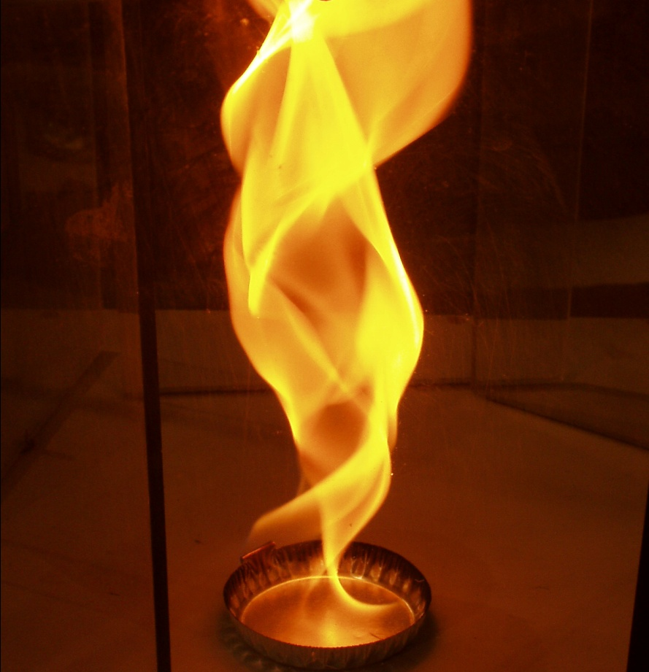
Kinetic
Thermal- results in systems temperature -->total movement of
atoms and molecules

Slide 13
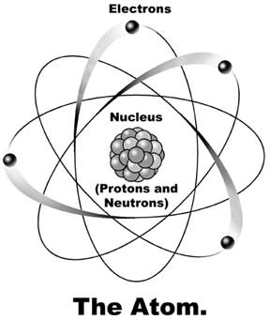
Kinetic
Electrical-movements of electrons -->available by the flow of electric charge

Slide 14
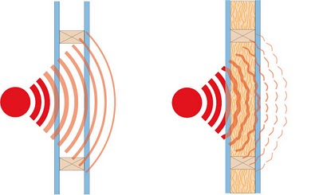
Kinetic
Sound: movement of energy through compression energy

Slide 15
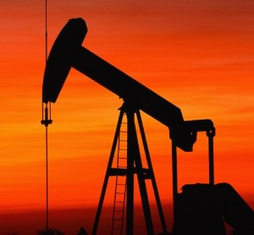
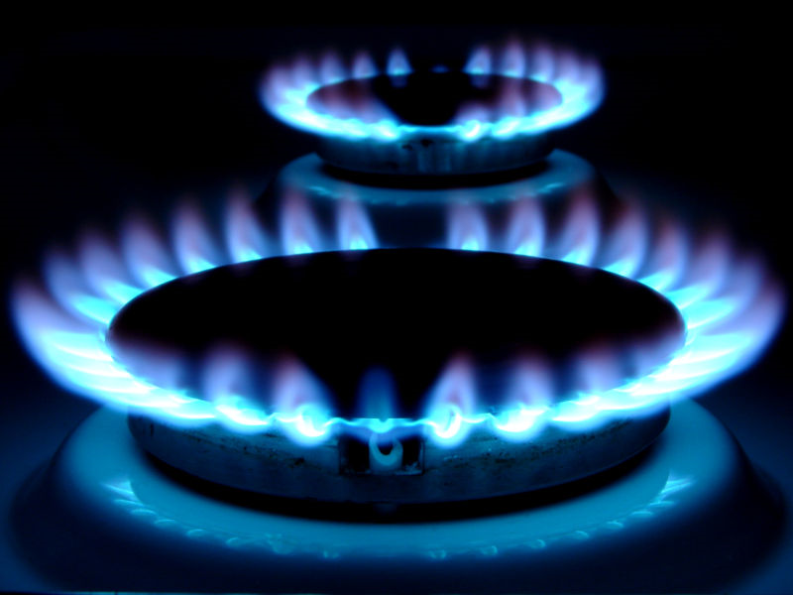
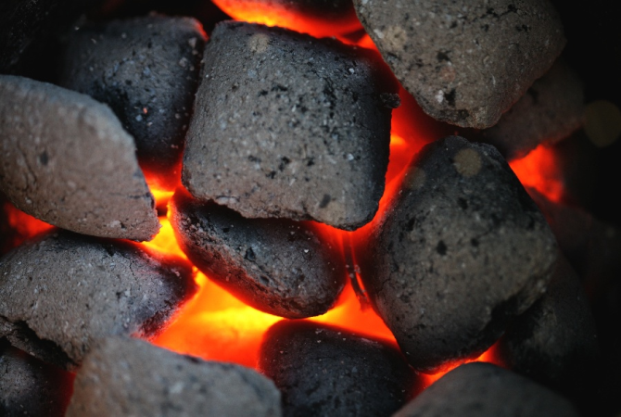
nonrenewable energy sources
oil, natural gas, and coal.
They're called fossil fuels because they were formed over millions and millions of years

Slide 16
What is solar energy?
Solar power is energy from the sun and without its presence all life on earth would end.
A simple example of the power of the sun can be seen by using a magnifying glass to focus the suns rays on a piece of paper. Before long the paper ignites into flames.

Slide 17
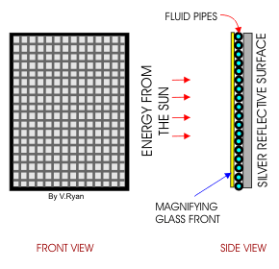
…
Fire is one way of using the suns energy, but flames are dangerous and difficult to control. A much safer and practical way of harnessing the suns energy is to use the suns power to heat up water.
Solar energy is now harnessed by modern technology.

Slide 18
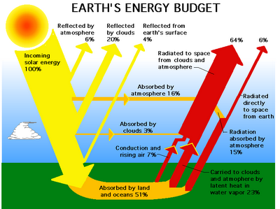

Slide 19
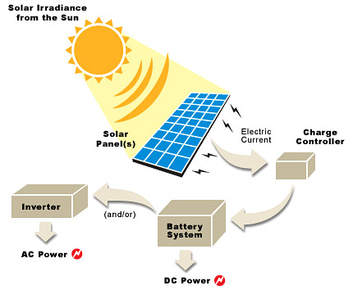

Slide 20
"What Is Solar Energy?" A Design and Technology Site. Web. 28 Sept. 2011. <http://www.technologystudent.com/energy1/solar1.htm>.
"Energy | Define Energy at Dictionary.com." Dictionary.com | Find the Meanings and Definitions of Words at Dictionary.com. Web. 02 Oct. 2011. <http://dictionary.reference.com/browse/energy>.
"EIA Energy Kids - Energy Basics." U.S. Energy Information Administration (EIA). Web. 02 Oct. 2011. <http://205.254.135.24/kids/energy.cfm?page=about_home-basics>.

